Slide 1
Job Data Analysis
Arjun M
22IDA001

Slide 2
Description of dataset:
The dataset consist of the fields:
Job title
Key skills
Location
Role category
Industry
Role
Salary
Latitude and longitude
Minimum and maximum experience

Slide 3
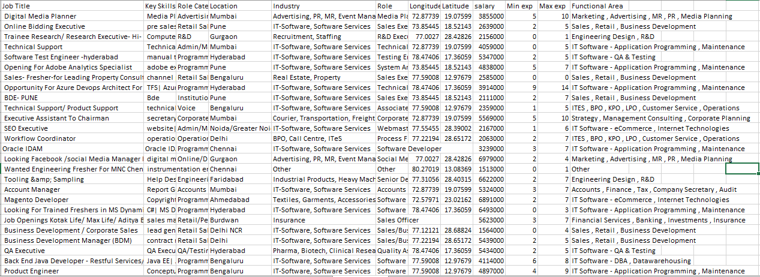
Dataset

Slide 4
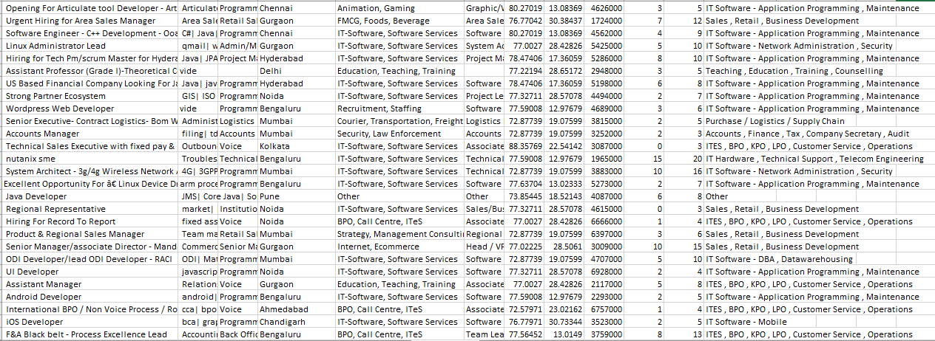

Slide 5
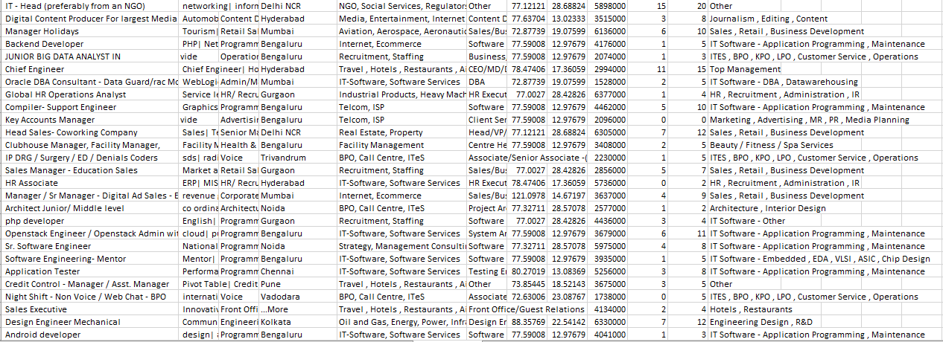

Slide 6
The dataset consist of 489 rows and the screen shots depicts only a preview of some of those

Slide 7
Number of jobs based on industry:
Frequency distribution

Slide 8
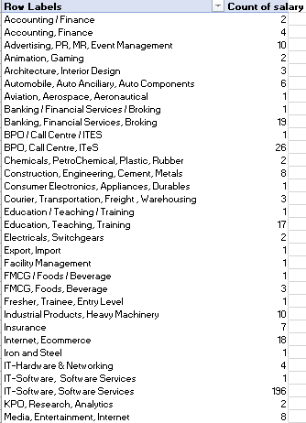
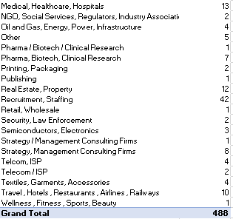

Slide 9
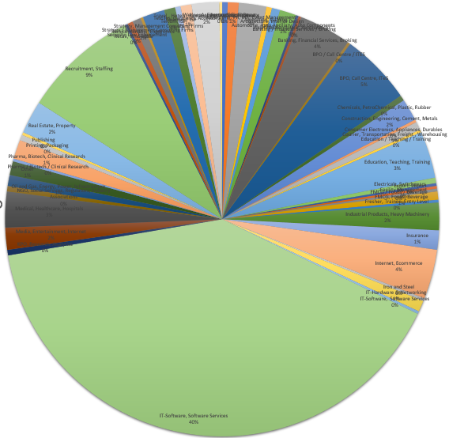
Pie chart for the data

Slide 10
Number of industries with respect to location
Bar chart

Slide 11
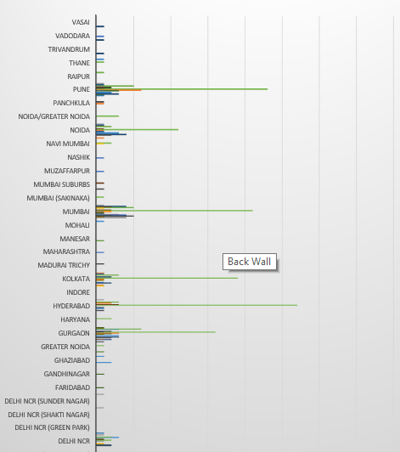

Slide 12
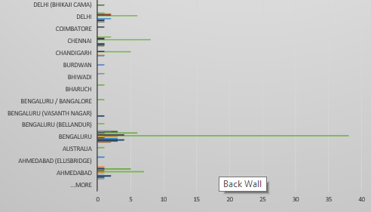

Slide 13
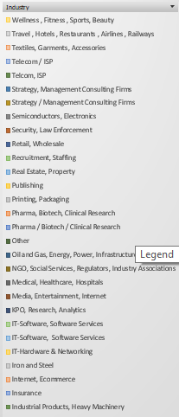
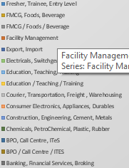

Slide 14
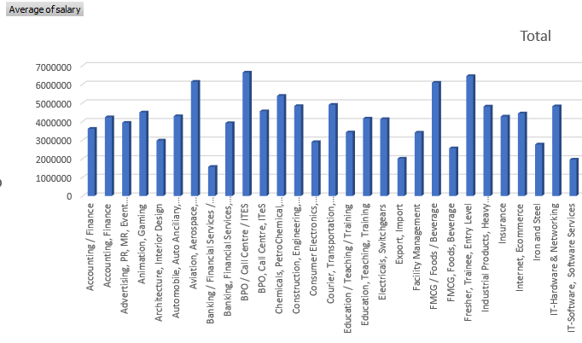
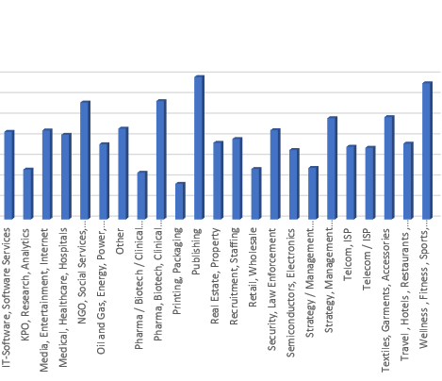
Mean salary based on industry

Slide 15
Average salary in IT-Software,Software services with respect to minimum experience

Slide 16
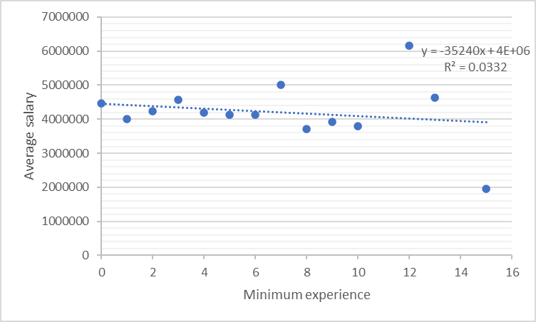
Linear Regression analysis

